Slide 1
Movie recommendation system
Made by:Akanksha Singh
K19JC

Slide 2
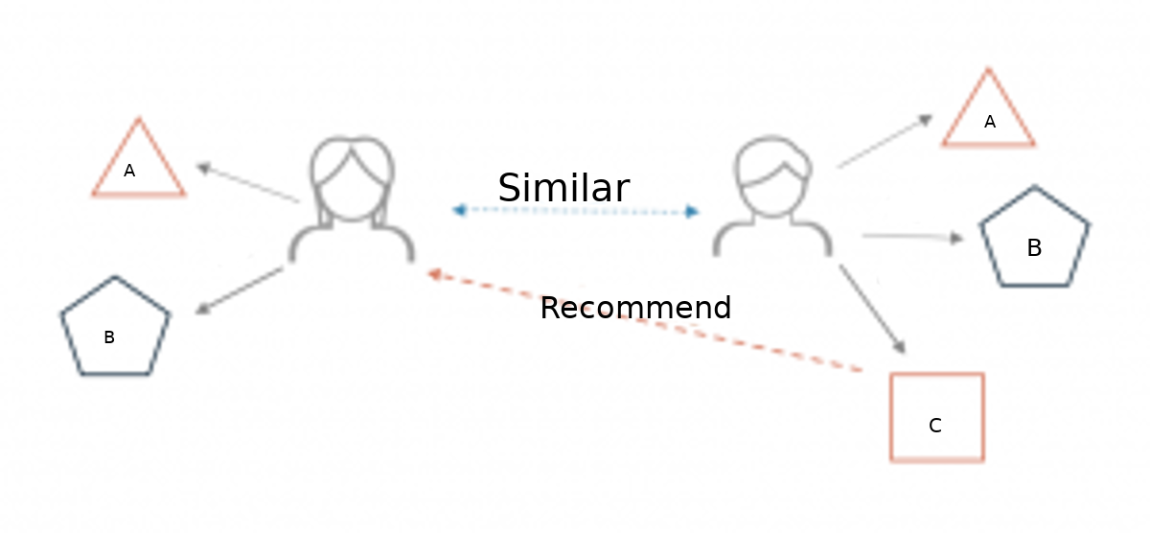
Movie recommendation system
What is a recommender system?
A recommender system is a simple algorithm whose aim is to provide the most relevant information to a user by discovering patterns in a dataset. The algorithm rates the items and shows the user the items that they would rate highly. An example of recommendation in action is when you visit Amazon and you notice that some items are being recommended to you or when Netflix recommends certain movies to you. They are also used by Music streaming applications such as Spotify and Deezer to recommend music that you might like.

Slide 3
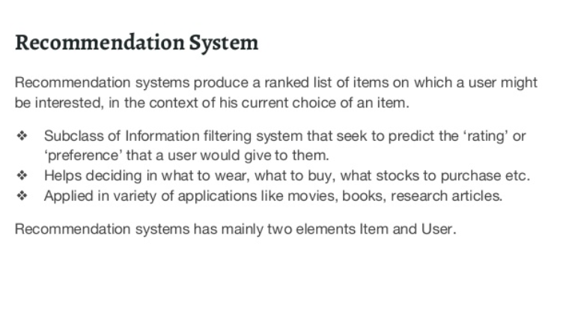

Slide 4
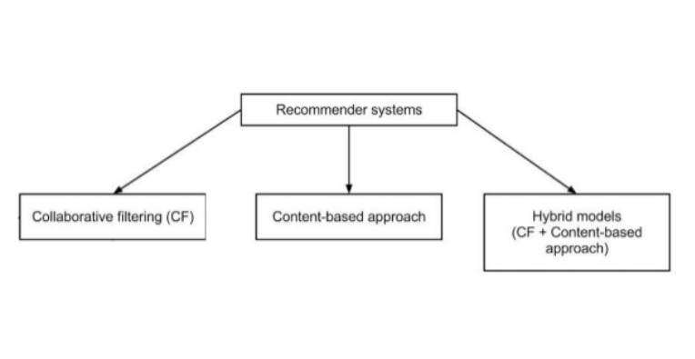
Different types of recommendation engines

Slide 5
•User-based collaborative filtering: In this model, products are recommended to a user based on the fact that the products have been liked by users similar to the user. For example, if Derrick and Dennis like the same movies and a new movie come out that Derick like, then we can recommend that movie to Dennis because Derrick and Dennis seem to like the same movies.
Item-based collaborative filtering: These systems identify similar items based on users’ previous ratings. For example, if users A, B, and C gave a 5-star rating to books X and Y then when a user D buys book Y they also get a recommendation to purchase book X because the system identifies book X and Y as similar based on the ratings of users A, B, and C.

Slide 6
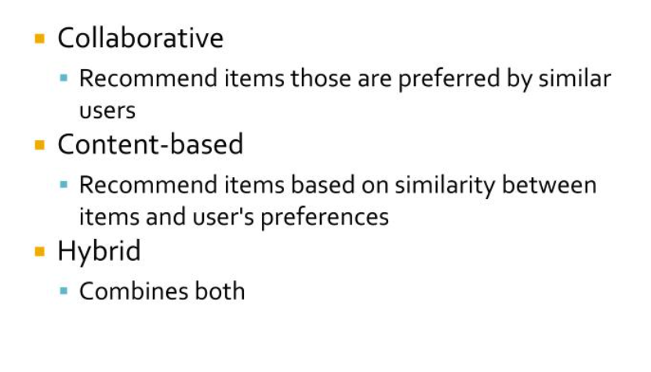

Slide 7
Recommendation System Benefits.
Deliver Relevant Content:
By analyzing the customer’s current site usage and his previous browsing history, a recommendation engine can deliver relevant product recommendations as he shops. The data is collected in real-time so the software can react as his shopping habits change.
Engage Shoppers:
Shoppers become more engaged in the site when personalized product recommendations are made. They are able to delve more deeply into the product line without having to perform search after search.
Convert Shoppers to Customers:
Converting shoppers into customers takes a special touch. Personalized interactions from a recommendation engine show your customer that he is valued as an individual. In turn, this engenders his loyalty.

Slide 8
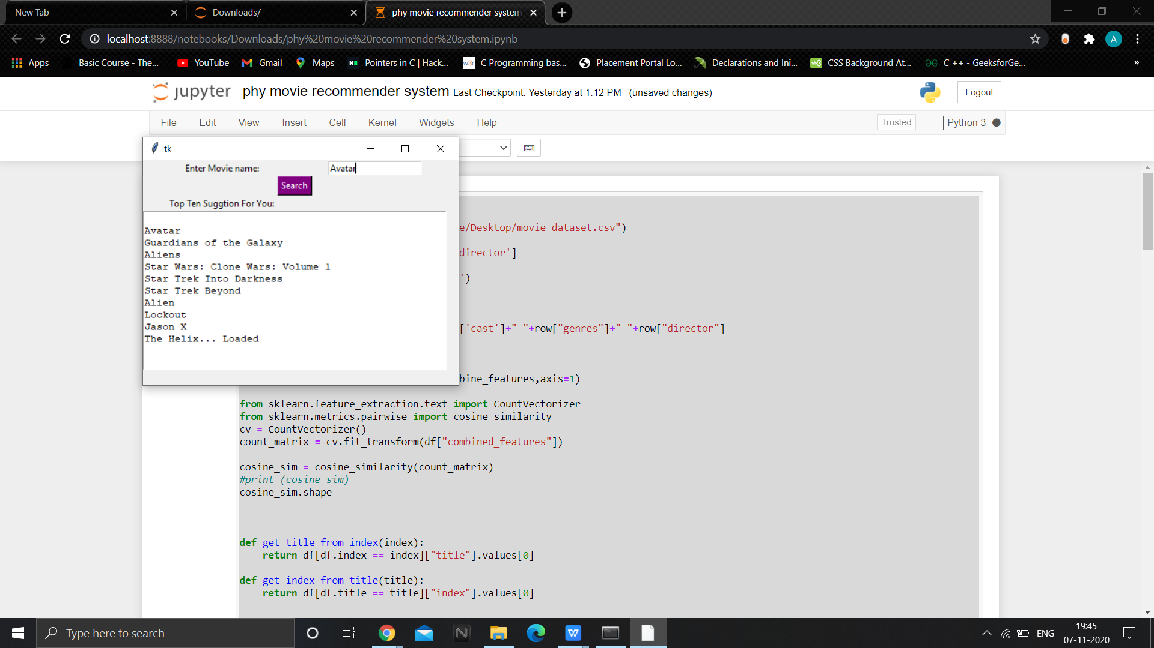
RESULT

Slide 9


